Slide 1
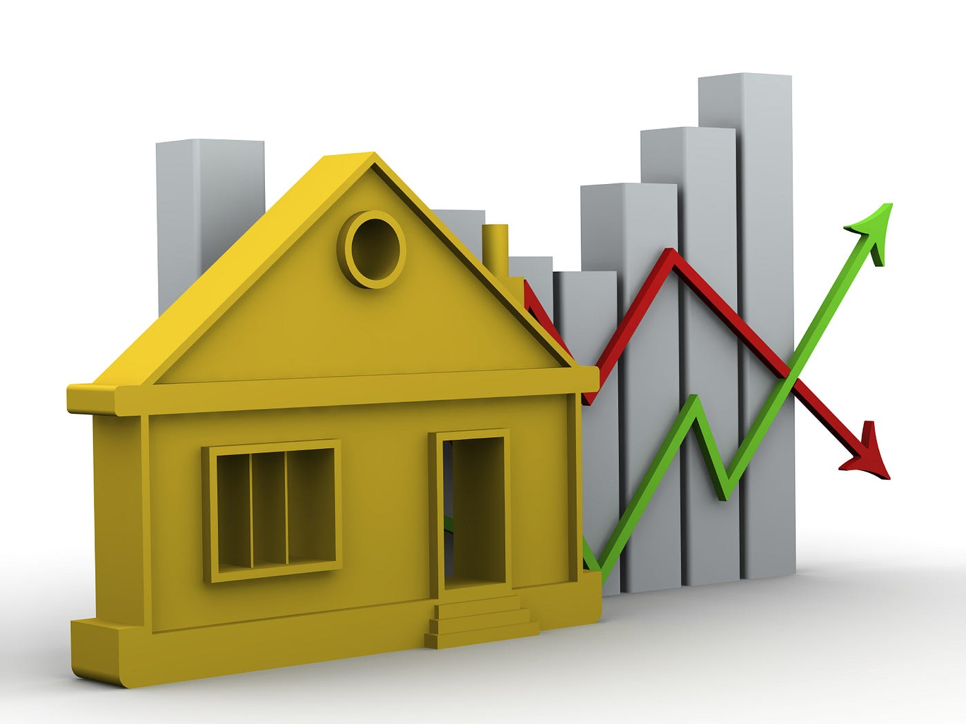
HOUSE PRICE PREDICTION
-Siddhant Saini(210962160)
Department of computer science and Engineering-MIT Manipal

Slide 2
ABSTRACT
This study addresses the prediction of housing prices using machine learning. With instances and continuous attributes plus one binary attribute, including the target variable denoting median home values, the project employs data preprocessing steps like imputation, feature scaling, and correlation analysis. The process involves splitting data into training and test sets using stratified shuffling, forming attribute combinations, and constructing a machine learning pipeline. Models such as Linear Regression, Decision Tree Regressor, and Random Forest Regressor are applied, utilizing cross-validation to evaluate performance. The objective is to determine the most accurate model for predicting housing prices, emphasizing the exploration of different algorithms.

Slide 3
INTRODUCTION
Utilizing a dataset containing 506 instances and 13 continuous attributes, alongside one binary attribute representing median home values ("MEDV"), this research aims to leverage machine learning models to forecast housing prices. By employing meticulous data preprocessing steps, including handling missing values and feature scaling, the study aims to optimize predictive accuracy. Through the implementation of a machine learning pipeline incorporating models like Linear Regression, Decision Tree Regressor, and Random Forest Regressor, the performance of these algorithms will be rigorously evaluated using cross-validation with Root Mean Squared Error (RMSE) as the primary metric. This research endeavours to identify the most effective model for predicting suburban Boston housing prices, offering insights into the applicability of machine learning techniques in the real estate domain.

Slide 4
Literature Review
Arthur Charpentier Known for his research in actuarial science and machine learning applications in insurance and finance, Charpentier has published work related to predictive modelling and risk assessment, which can be relevant to housing price prediction.
Steven D. Levitt Co-author of the book "Freakonomics," Levitt's research on applied economics and unconventional datasets might contain unconventional approaches to understanding housing markets and prices.
Matthew E. Kahn Known for research on environmental and urban economics, Kahn's work on factors influencing housing markets, such as environmental amenities and transportation, can be relevant to housing price prediction models.

Slide 5
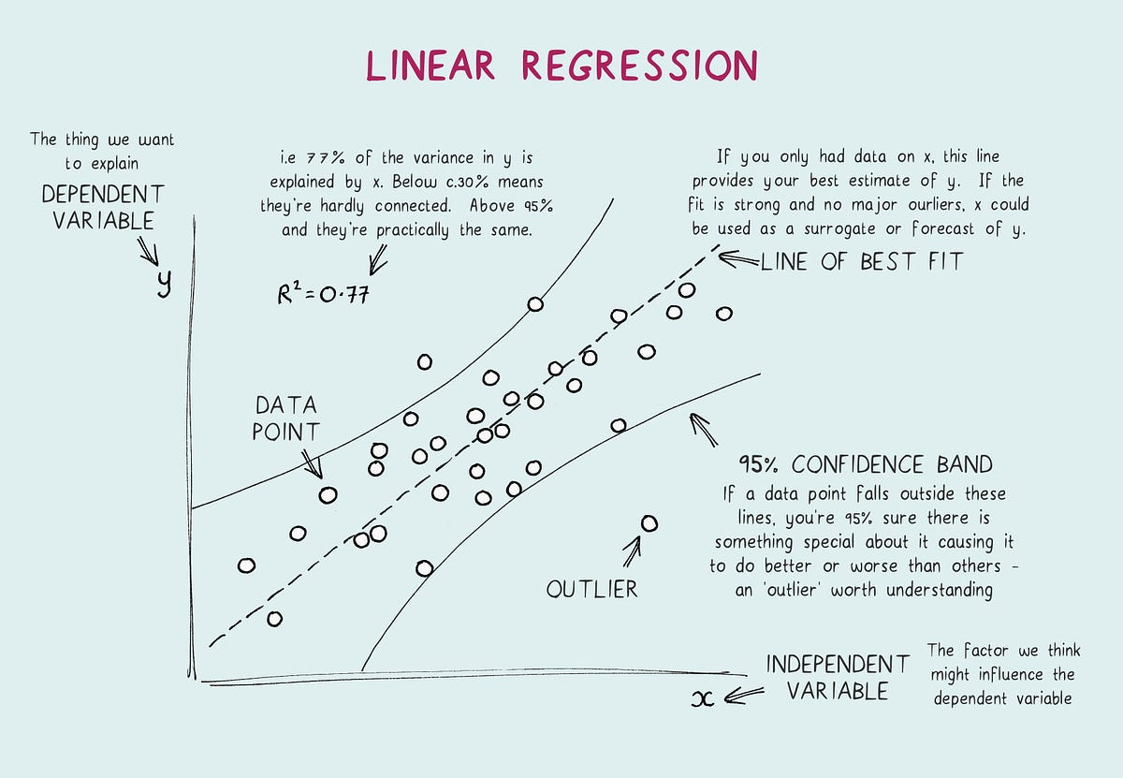
Linear regression
Linear Regression establishes relationships between variables by fitting a linear equation to data. While simple and interpretable, it assumes linear relationships and might struggle to capture nuanced patterns in housing price prediction.

Slide 6
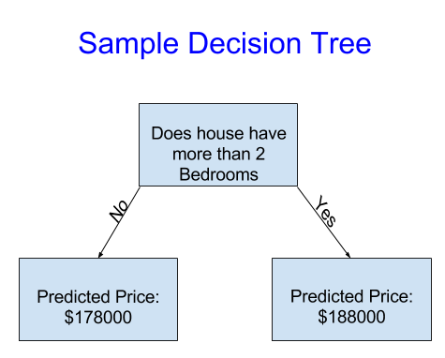
The Decision Tree Regressor segments data based on attribute values to form a tree-like structure for sequential decision-making. Its interpretability is useful for capturing complex relationships in housing price prediction, but it may overfit due to complex trees memorizing noise in the data.
Decision Tree Regressor

Slide 7
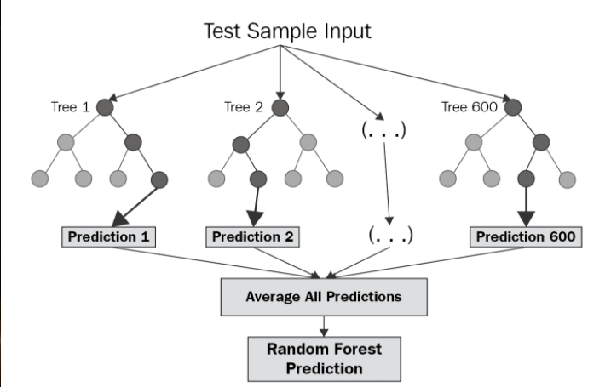
Random Forest Regressor
The Random Forest Regressor combines multiple decision trees to refine predictions. Handling non-linear relationships and high-dimensional data, it offers robust predictions by aggregating outputs, reducing overfitting, and enhancing accuracy in housing price predictions.

Slide 8
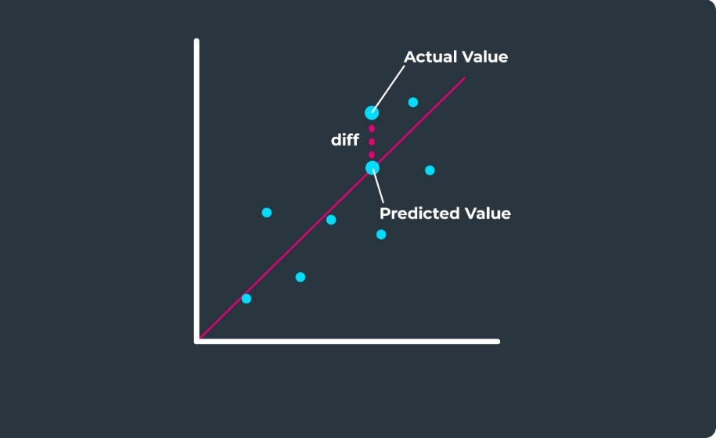
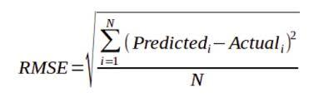
RMSE(root mean squared error)
In comparing regression models, the Root Mean Squared Error (RMSE) revealed that the Random Forest Regressor exhibited the lowest error, indicating its superior predictive accuracy for housing price prediction in suburban Boston. This lower RMSE led to the selection of the Random Forest model over others, emphasizing its efficiency in capturing complex relationships and diverse attributes, thus making it the preferred choice for this task.

Slide 9
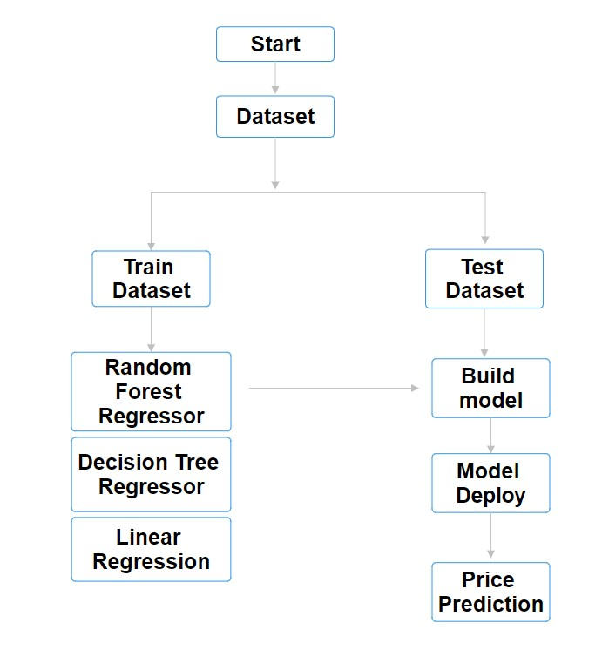
Methodology
Data collection and preprocessing
Feature engineering
Looking for correlations
Missing Attributes
Feature Scaling
Selecting a desired model
Testing the model

Slide 10
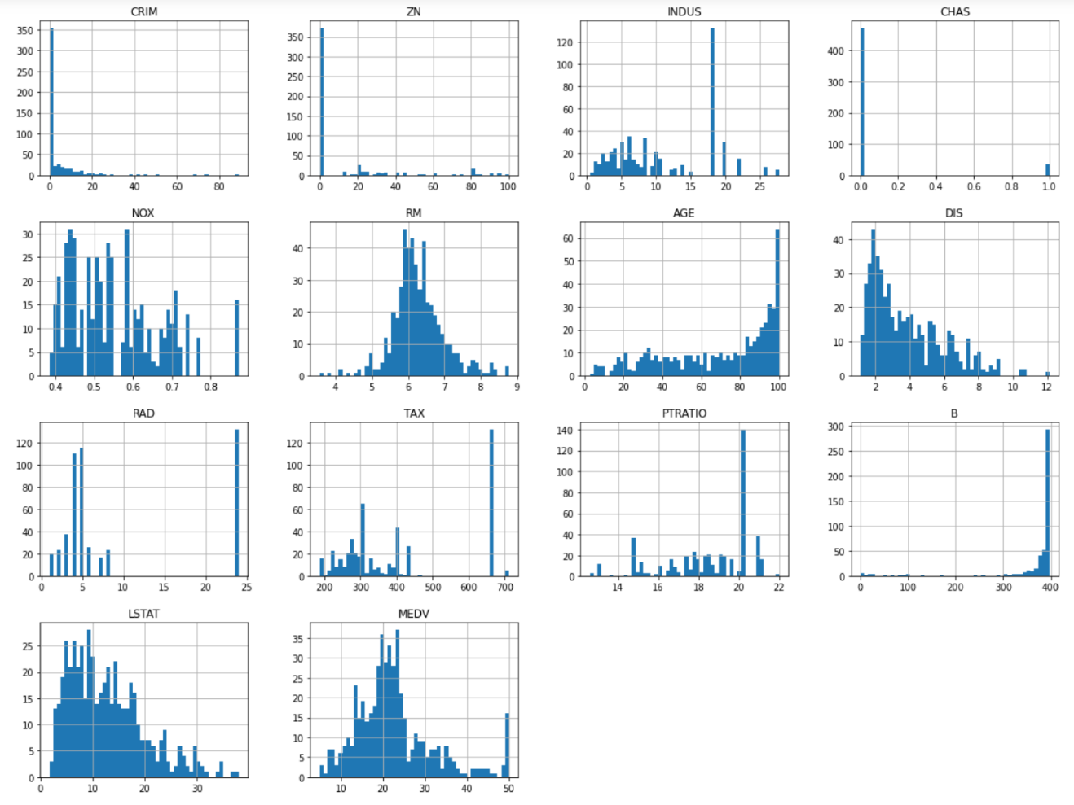
1.Data collection and preprocessing
The datasets used, namely "House_Price.csv" and "City_Price.csv," were obtained from UCI reliable sources, ensuring a diverse representation of updated articles. Preprocessing involved several essential steps to prepare the data for analysis. The datasets were loaded using Pandas, missing values were handled. Subsequently, a comprehensive data cleaning process was implemented using the Histogram plotting, gives us an idea about the features.
Attribute Information: CRIM, ZN, INDUS, CHAS, NOX, RM, AGE, DIS, RAD, TAX, PTRATIO, B, LSTAT, MEDV

Slide 11
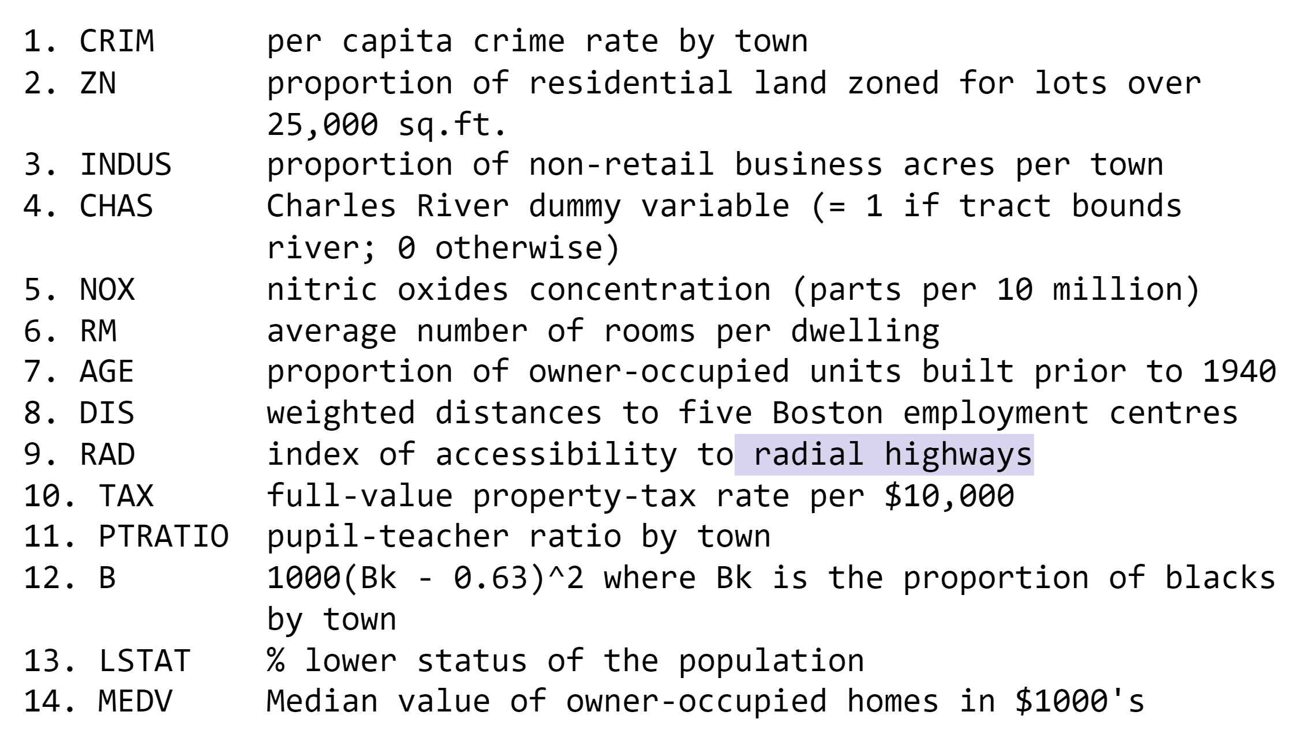
Dataset

Slide 12
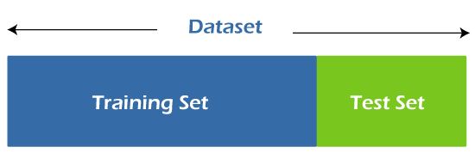
2.Feature Engineering
The dataset was split into training and testing sets using Scikit-Learn's train test split () function, with the training set utilized to train the models. Here, we have used a function Stratified Shuffle Split that helps in equal distribution of important features categories in train and test data.

Slide 13
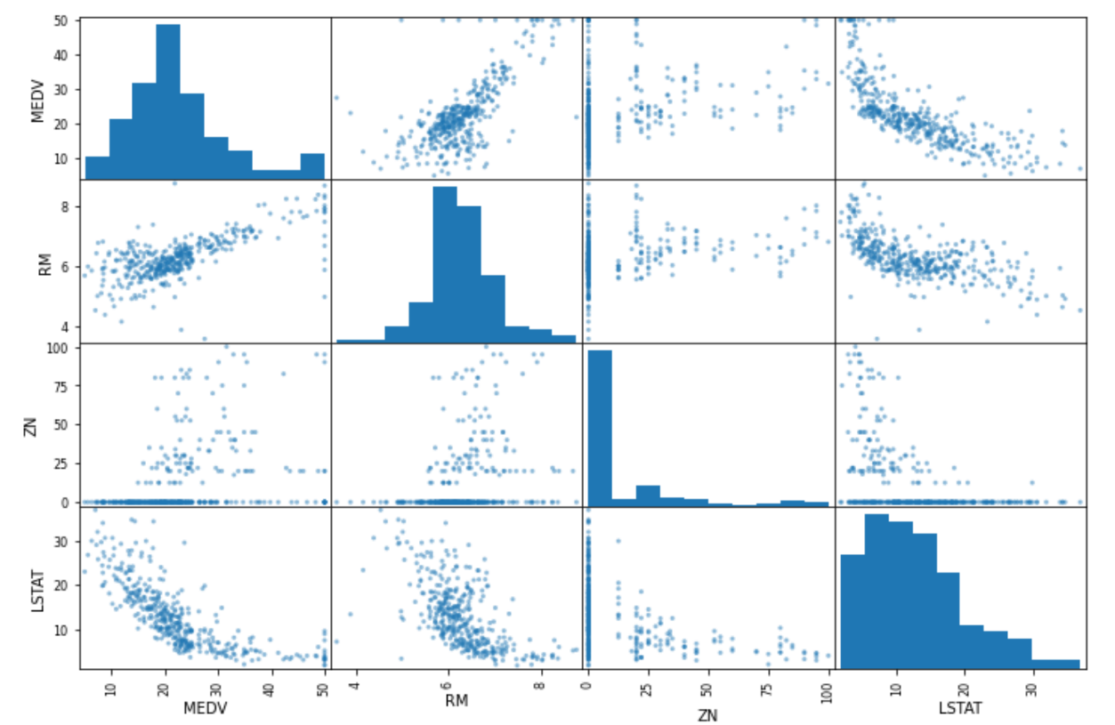
3.Looking for correlations
The Result of the correlation method is a table with a lot of numbers that represents how well the relationship is between two columns. The number varies from -1 to 1. 1 means that there is a 1 to 1 relationship (a perfect correlation), and for this data set, each time a value went up in the first column, the other one went up as well.

Slide 14
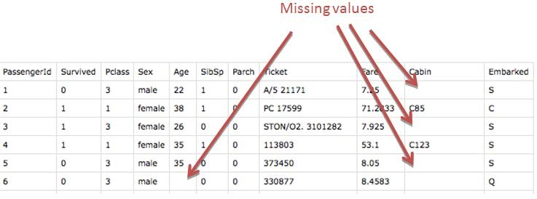
4.Missing Attributes
Handling missing data in a dataset involves three primary options: removing data points with missing values, dropping entire attributes with missing data, or using techniques like the Simple Imputer from scikit-learn to replace missing values with a constant, mean, or median. Simple Imputer offers a streamlined way to tackle missing values, ensuring a more complete dataset for analysis or modelling purposes. The choice among these strategies depends on the dataset's context and the impact of missing data on the intended analysis.

Slide 15
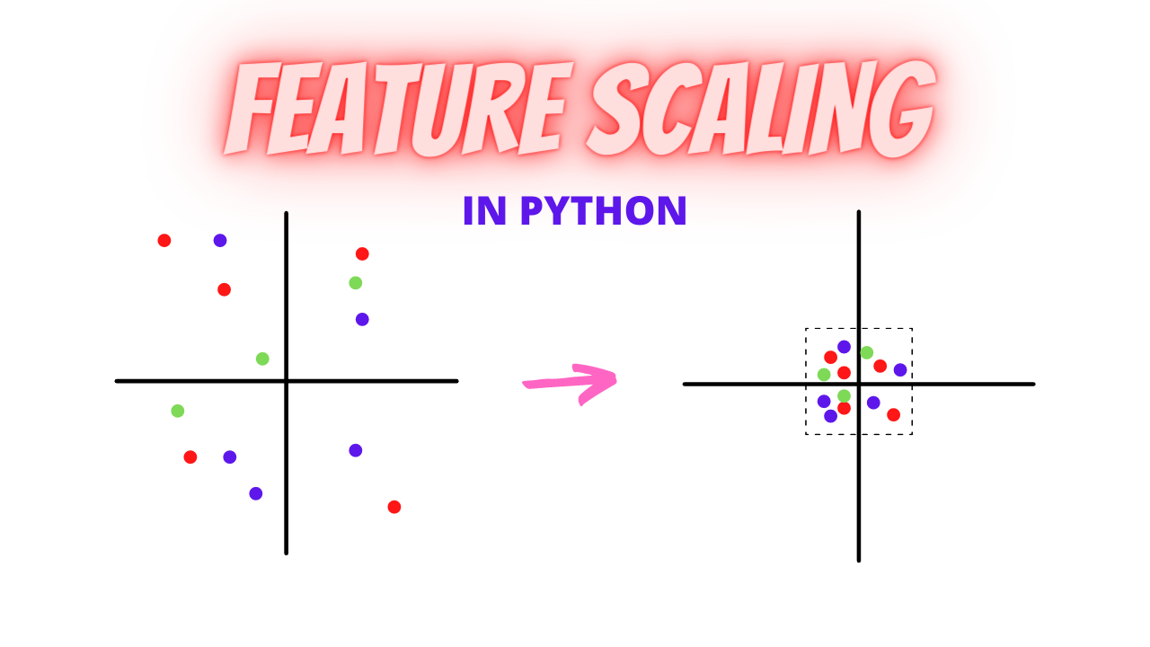
5.Feature Scaling
Feature scaling is a crucial preprocessing step in machine learning, ensuring that variables are on a similar scale. Two popular methods for scaling data are Min-max scaling, also known as normalization, and Standardization. Min-max scaling re-scales data to a range between 0 and 1, preserving relative distances between values. Sklearn’s MinMaxScaler class simplifies this process. Conversely, Standardization centres the data around mean 0 and standard deviation 1, making it robust to outliers. Sklearn's StandardScaler class performs this transformation. The choice between these methods depends on the nature of the data and the specific requirements of the machine learning algorithm being used.

Slide 16
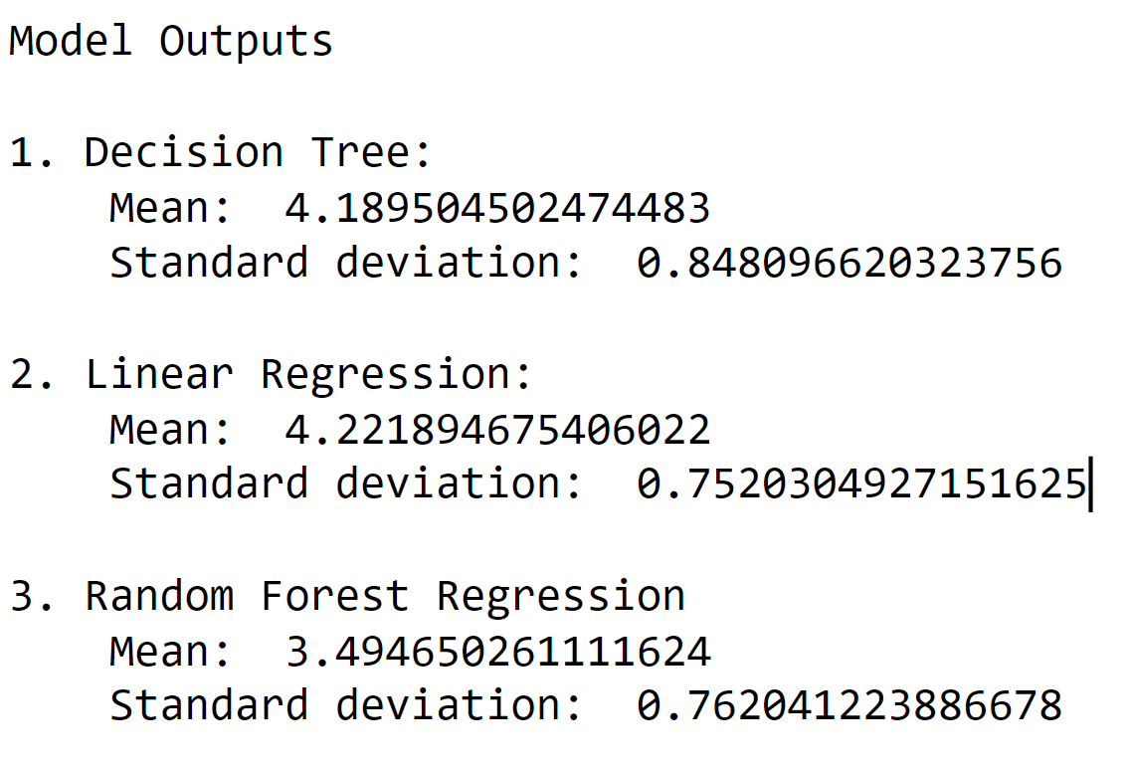
6.Selecting a desired model
Selecting the optimal model for housing price prediction involves evaluating regression-based algorithms like Linear Regression, Decision Tree Regressor, and Random Forest Regressor. Assess these models based on simplicity, interpretability, and predictive performance using metrics like RMSE. Aim for a balanced choice that balances interpretability and accuracy while meeting project objectives and stakeholder needs for precise housing price forecasts.

Slide 17
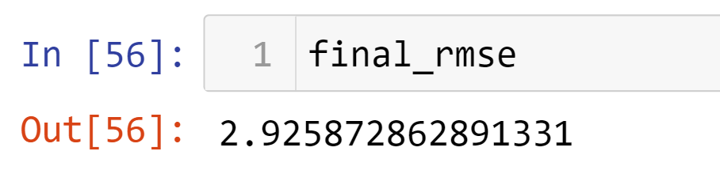
7. Testing a model
Testing the model in the housing price prediction project involves deploying the chosen algorithm on the test dataset, which was set aside during the training phase. This step assesses the model's performance on unseen data to validate its generalization ability. By feeding the test dataset into the trained model, calculate evaluation metrics such as RMSE to quantify the predictive accuracy. Ensure the model doesn't overfit, meaning it performs well not just on the training data but also on new, unseen data. Analyze the model's performance insights gleaned from testing to confirm its reliability in making accurate predictions for housing prices in the suburban Boston area.

Slide 18
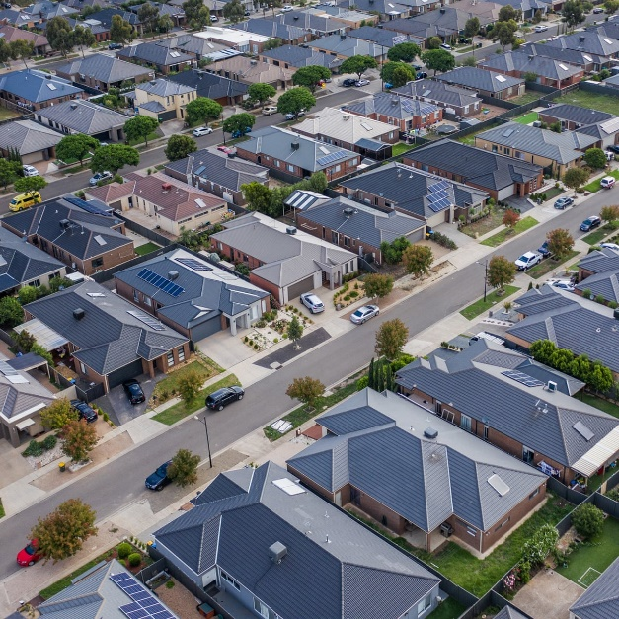
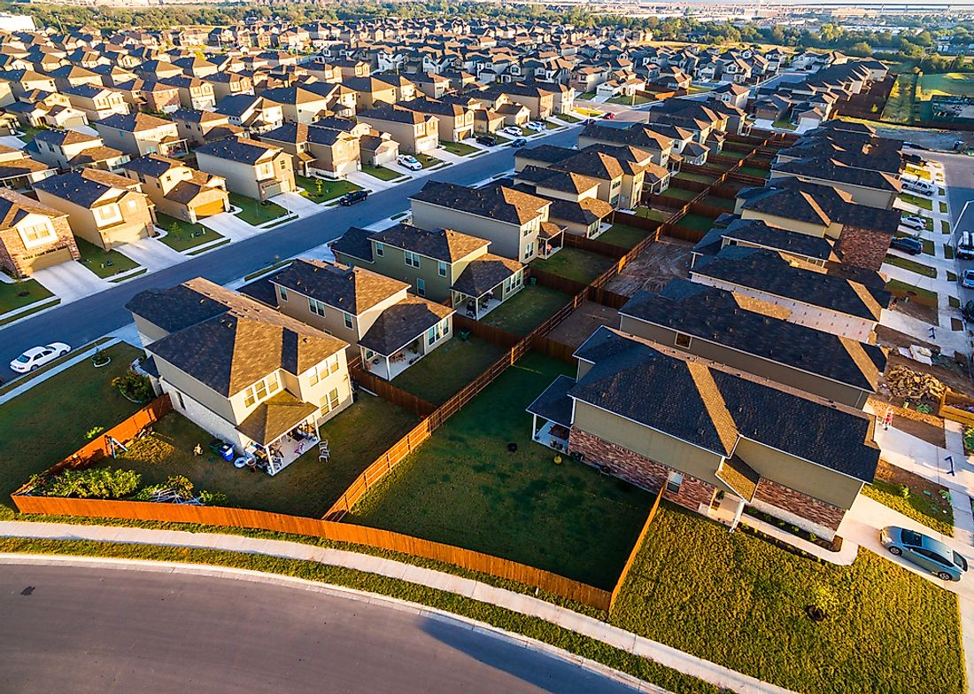
Conclusion
In conclusion, employing machine learning models like the Random Forest Regressor holds promise for accurate housing price prediction in suburban Boston. The model's superior accuracy highlights its potential, yet trade-offs between complexity, interpretability, and performance demand careful consideration. Continual model refinement is essential for enhancing accuracy and ensuring practical usability in real estate decision-making within this dynamic market.

Slide 19

Future work
Study of Regional Variations: Conduct focused studies to understand and refine models for localized predictions within diverse neighbourhoods or regions in the suburban Boston housing market.
Continuous Model Refinement: Ensure ongoing refinement and adaptation of models to keep pace with evolving market conditions, maintaining relevance and accuracy in a dynamic real estate landscape.
Integration of Additional Data Sources: Enhance models by incorporating diverse data sources such as demographic trends, environmental factors, or real-time market data to provide a more comprehensive understanding of housing market variations.

Slide 20




Applications
Investment Optimization: Helps investors make informed decisions on buying, selling, or holding properties for optimal portfolio management.
Accurate Valuation: Assists appraisers and agents in determining precise property values using various factors and historical data.
Financial Planning: Aids buyers and sellers in understanding potential financial impacts and planning for mortgages or budgeting.
Risk Assessment for Lenders: Enables lenders to assess loan risks better, improving decision-making for loan approvals and interest rates.
Urban Planning Insights: Supports city planners in understanding housing market trends and demands for efficient urban development and policy-making.

